Slide 1

Draw Motion: Real-Time Hand Gesture Tracking and Interactive Drawing System
Birla Vishvakarma Mahavidyalaya
[ An Autonomous Institution ]
Information Technology Department
3IT31 – Mini Project
Presented By :
Akshay Gojiya (22IT452)
Shlok Goswami (22IT461)
Sai Mistry (22IT451)
Guide :
Dr. Nilesh B. Prajapati

Slide 2
Table of contents
01
Introduction
02
Objectives and Scope
03
Requirements
04
Modules
05
Feasibility Study
06
Requirement gathering
07
Literature Review
08
Diagrams
09
Implementation

Slide 3
DrawMotion
What is it?
DrawMotion is a real-time hand gesture tracking and interactive drawing system that enables users to draw on a virtual canvas using finger movements.
Unlike traditional methods that rely on external libraries like OpenCV or MediaPipe, this project is built entirely from scratch, using custom algorithms for hand detection, tracking, and gesture recognition.
The system ensures high accuracy, real-time performance, and seamless user interaction, making it suitable for applications in education, creative tools and AR/VR.

Slide 4
Objectives and Scope
Objectives
Scope
Custom Hand Detection & Tracking
Real-Time Performance (Minimal lag)
Gesture-Based Drawing
No Third-Party Libraries
Scalable for AR/VR, Accessibility
Real-Time Gesture Tracking
Custom Algorithm Development
Compatible with various devices
Future Scalability (Multi-hand, AR/VR, etc.)

Slide 5
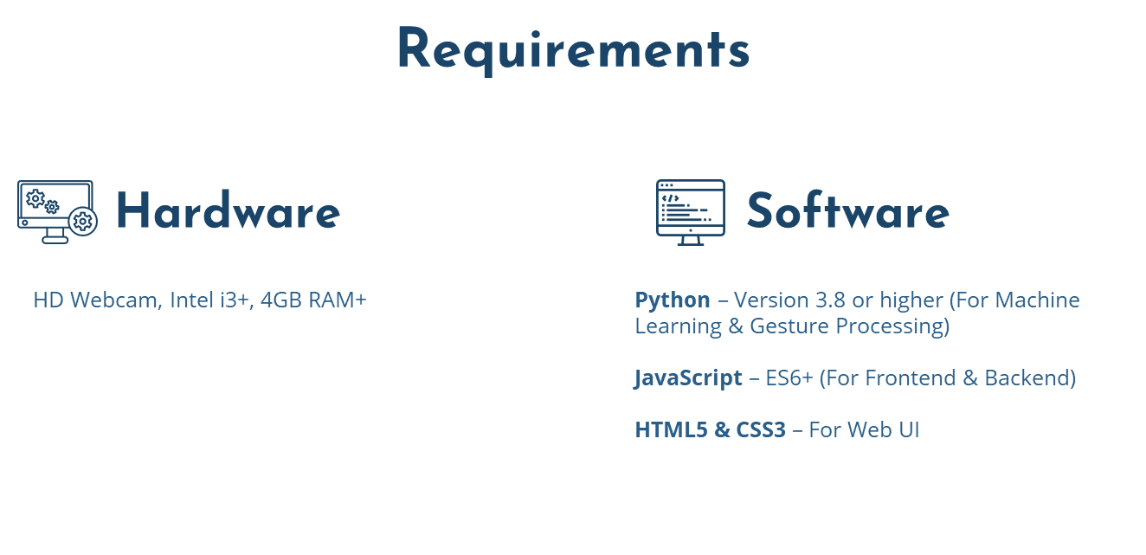

Slide 6
Modules
01
Video Capture
04
Gesture Recognition
Fetches live feed
Identifies finger movements
02
Hand Tracking
05
UI & Event Handling
Detects hand positions
Manages interactions
03
Drawing Module
Custom Algorithm Module
06
Converts gestures into drawing
Implements ML-based gesture
classification.

Slide 7
Feasibility Study
Technical Feasibility
Technology Availability, Accuracy and Reliability
Operational Feasibility
Ease of Use, User Training
Economic Feasibility
Development Cost, Maintenance Cost, Market Potential

Slide 8
PROJECT REQUIREMENT GATHERING
Techniques : Research and Literature Review, surveys, Prototyping.
Comparison :
Feature | MediaPipe/OpenCV-Based Systems | DrawMotion (CustomBuilt)
Dependency on Libraries | High | None
Algorithm Control | Limited | Full Control
Scalability | Medium | High
Customization of Features | Limited | Fully customizable

Slide 9
Literature review
Hand Gesture Recognition Using Deep Learning
Real-Time Hand Tracking and Gesture Recognition for Human-Computer Interaction
Interactive Drawing Systems Using Hand Gestures
Vision-Based Hand Gesture Recognition for Assistive Technologies
Real-Time Hand Gesture Recognition using Motion Tracking

Slide 10
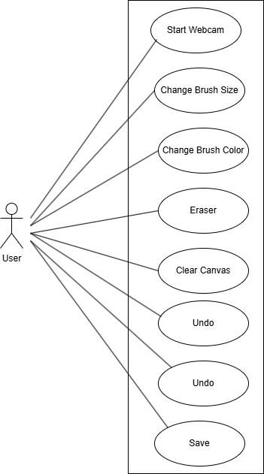
Use Case Diagram
SRS Link : Drive

Slide 11
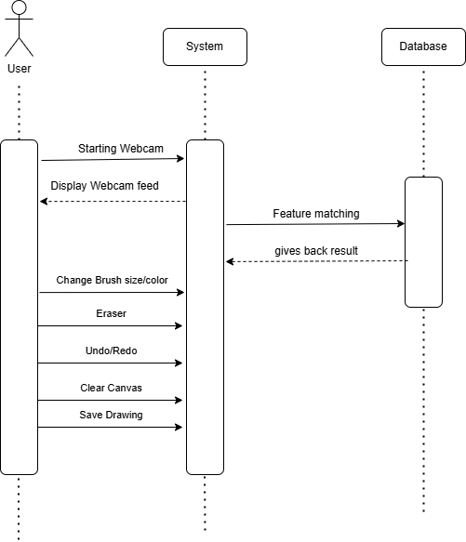
Sequence Diagram

Slide 12
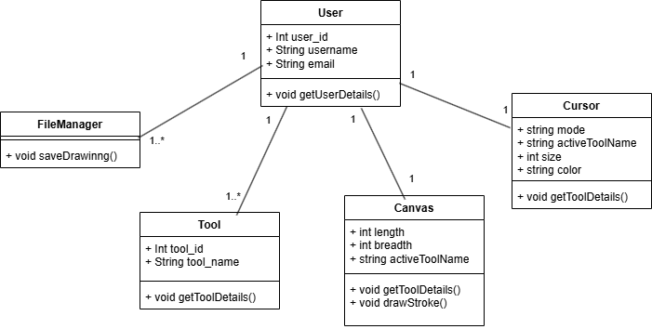
Class Diagram

Slide 13
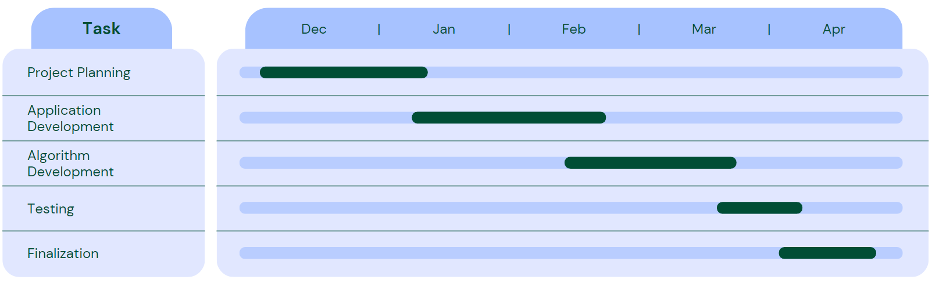
Timeline Chart

Slide 14

Implementation

Slide 15
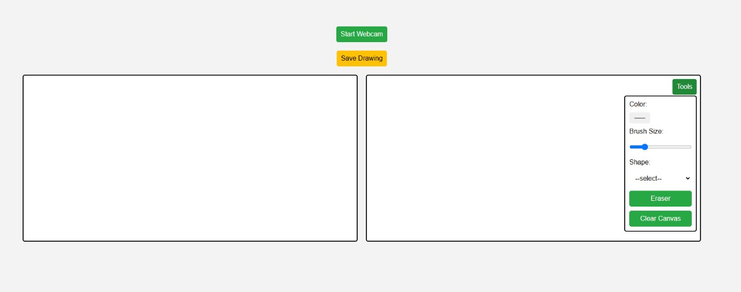
Implementation

Slide 16

Implementation

Slide 17
Thank You

